Slide 1


SUNSTONE
“ Calendar scheduler application”
Task - 5

Slide 2


SUNSTONE
Project Name : “ Calendar scheduler Application ”
In today's fast-paced and dynamic world, effective time management is crucial for both individuals and organizations. The need for a reliable and user-friendly tool to schedule and organize events, meetings, and tasks has never been more significant. To address this demand, we propose the development of a cutting-edge Calendar Scheduler Application.
S.NO | LMS Username | Name | Batch
1 | @jayashri18 | Jayashri V | 4
2 | @gopika20 | Gopika M | 4
3 | @keerthiga2003 | Keerthiga S | 4
4 | @Manthra117 | Manthara G | 4

Slide 3
Task 5 :: Hosting (Module 5)
Hosting the website so that it can be accessed from anywhere
Host backend on AWS with all environment setup
Make sure to whitelist API ports and host with the database
Migrate database to Mongodb atlas
Build react app to be hosted on the server
Set hosted backed URL to the frontend
Test entire frontend and backend
Evaluation Metric:
100% Completion of the above tasks
Learning outcome
Understand how to host a web API
How to deploy production ready react applications
Setting up environment for production

Slide 4
SUNSTONE
Step-Wise Description
1.Define Scope and Tech Stack
Identify key features: date/time, reminders, recurring events.
Choose a scalable tech stack for efficient development.
2. UI/UX and Frontend:
Design an intuitive, responsive interface.
Develop frontend for seamless user interaction.
3. Functionality and Integration:
Enable easy date/time selection and recurring events.
Integrate with address book for efficient location input.
4.Task Organization:
Implement task prioritization, inspired by a shopping cart concept.
Allow users to categorize and label events for better organization.
5.Testing, Deployment, and Support:
Conduct thorough testing for functionality and security.
Deploy on a reliable platform and provide user support.
Summary of your task
The project aims to develop a calendar scheduler application, minimizing manual scheduling efforts. It will efficiently manage appointments, tasks, and events while providing details on user schedules, ensuring seamless organization.

Slide 5
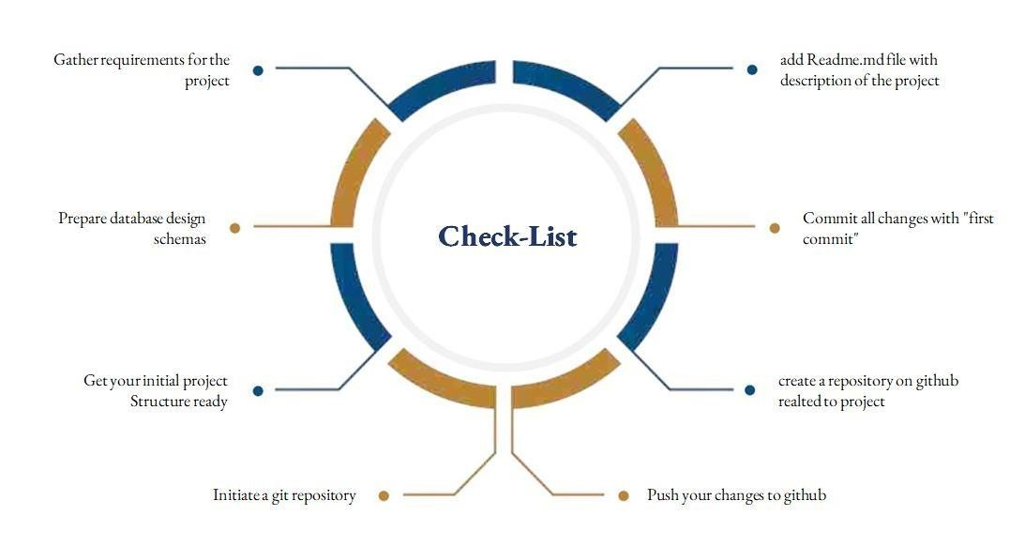
SUNSTONE
Assesment Parameter

Slide 6
Submission Github
SUNSTONE
https://github.com/jayashri-18/NM--AIT--GROUP4.git

Slide 7


SUNSTONE

